Slide 1

FLIGHT: PRICE PREDICTION
Flight ticket prices can be something hard to guess, today we might see a price, check out the price of the same flight tomorrow, it will be a different story. We might have often heard travellers saying that flight ticket prices are so unpredictable.
FLIP ROBO REMOTE INTERNSHIP
Developed By:
Deepam Purkayastha

Slide 2
Problem Statement:
Flight ticket prices can be something hard to guess, today we might see a price, check out the price of the same flight tomorrow, it will be a different story. We might have often heard travellers saying that flight ticket prices are so unpredictable.
1. Time of purchase patterns (making sure last-minute purchases are expensive)
2. Keeping the flight as full as they want it (raising prices on a flight which is filling up in order to reduce sales and hold back inventory for those expensive last-minute expensive purchases)
Objective:
Here, with the help of the prices of flight tickets for various airlines, which has been scrapped from yatra.com & Ixigo.com for the months of November 2021 for few cities, we would be able to predict flight prices with the help of real time data.

Slide 3
Data analysis to model building flowchart
Import Libraries
Dataset Collection
Data preprocessing
Encoding(if required)
EDA
Checking Null Values
Checked for co-relation
Checked for Outliers/Skewness
Proceed for Model building(Train/Test)
Saving the Model
Hyper Parameter Tuning
R2 Score, Cross Validation, MSE, RMSE, MAE

Slide 4
Data Pre-processing Done
Importing Libraries.
Read the CSV file and convert into data frame.
Checking the data dimensions for the original dataset.
Looking for null values if any, in heat map. & accordingly fill the NaNs.
Checking the summary of the dataset.
Checking unique values.
Checking all the categorical columns in the dataset.
Visualizing each features using matplotlib and Seaborn.
Performed encoding if required.
Checked for co-relation/multi-collinearity.
Checked for Outliers/Skewness & act accordingly.
Perform Scaling using minmax Scaler method.
Checked for the final dimension of dataset: 1520 rows & 9 columns.
Created train test split: We have split the train & test data in 0.2 test size with finding the best random state, which is 101.

Slide 5
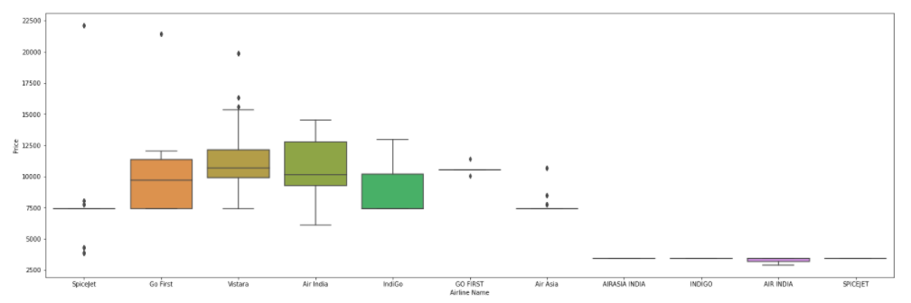
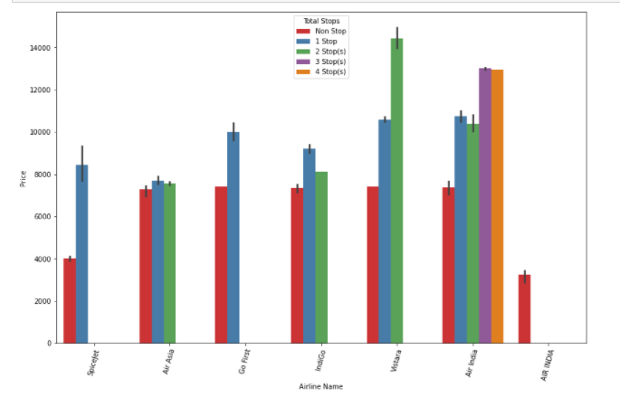
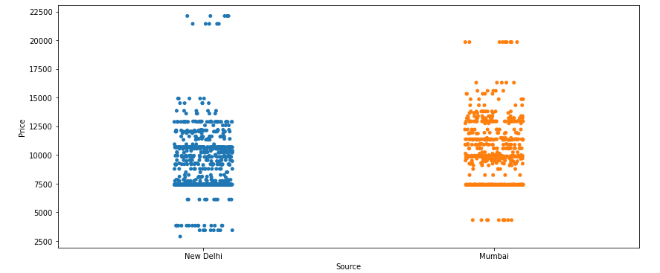
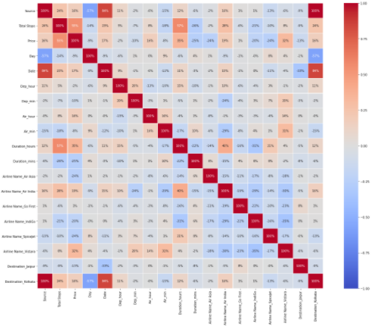
Exploratory Data Analysis through Visualizations
Spice jet is selling tickets with maximum fare followed by Go first & Vistara.
Maximum fare of the flights is departing from New Delhi followed by Mumbai.
Maximum destination is Kolkata having highest avg fare.
Vistara is showing the highest price having a 2 stops followed by 1 stop.
We have seen how categorical data is distributed & correlated with the target variable. Also, I have mentioned the findings below each plot.
Performed One Hot Encoding for Nominal categorical columns: Airline & Destination & performed label encoding for an ordinal categorical column: Total Stops, Source & Day.
No need to check for outliers/skewness as all the independent features are categorical.
Total stops is more correlated with target variable.
Multi collinearity: Date & Source, Date & Destination Kolkata.

Slide 6
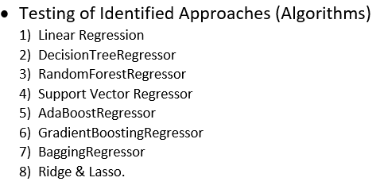
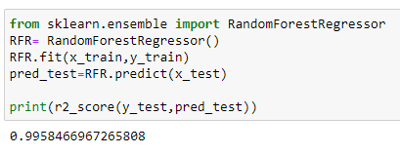
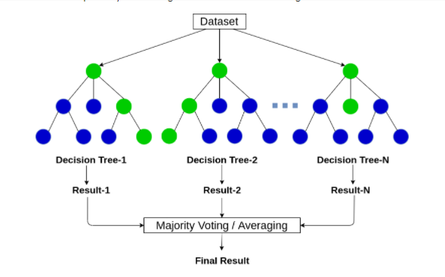
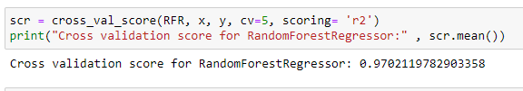
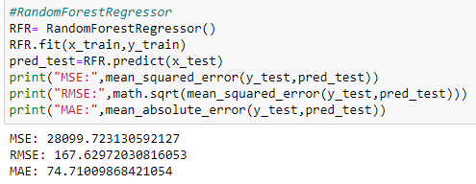
Model/s Development and Evaluation :
I have performed multiple algorithms to get the best model, and found out Random Forest Regressor is the best fit model out of all the other algorithms based on Cross validation, R2 Score, MSE, RMSE, MAE as shown in this slide.

Slide 7
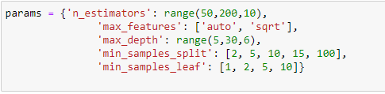

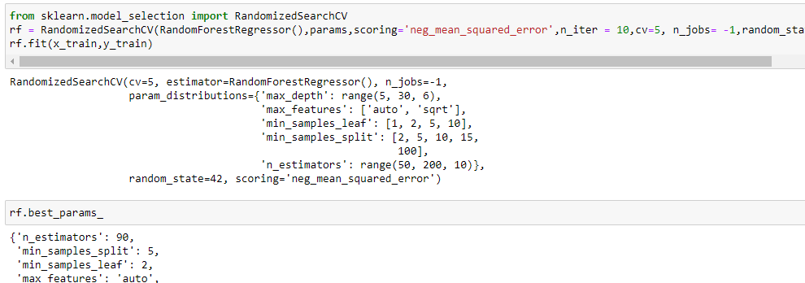
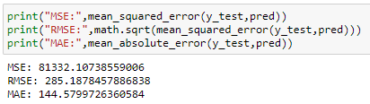
Hyper Parameter tuning
After using hyper parameter tuning, we observe accuracy could not increase. So I have kept the original accuracy of Random Forest Regressor, which gives 99% score with less MSE, RMSE & MAE error out of other models.

Slide 8
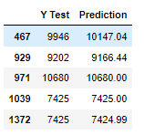
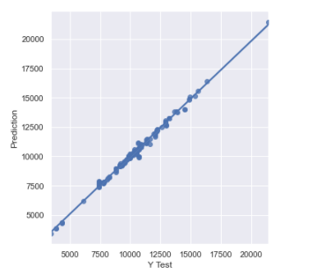
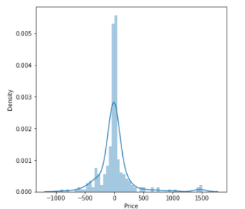
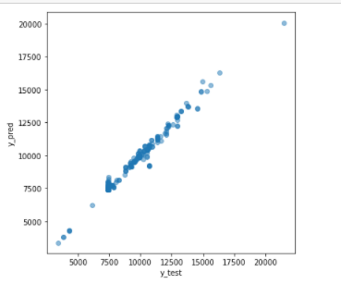
Conclusion
After performing the model building, I have got the highest score for RandomForestRegressor with 99% R2 score having less MSE, RMSE & MAE error as compare to other models but it could be due to overfitting, so I have checked for the cross validation scores & found 97% score, which gives very less difference between R2 score & CV score. Hence, based on Cross Validation Score, R2 score having less MSE, RMSE & MAE error, I have got the best fit model is RandomForestRegressor.
Also, the prediction is showing a similar relationship with the actual price from the scrapped data set, which means the model predicted correctly & this could help airlines by predicting what prices they can maintain. It could also help customers to predict future flight prices and plan the journey accordingly because it is difficult for airlines to maintain prices since it changes dynamically due to different conditions. Hence by using Machine learning techniques we can solve this problem.

Slide 9
Thank you

